Slide 1


Slide 2
Conference Theme
Guided Pathways: Lea(r)ning into future trends
Our College is engaging in three (3) system-level changes:
Fostering equitable outcomes in all of our professional practices;
Designing and evaluating Guided Pathways; and
Successfully implementing ctcLink.
These change initiatives require our ability to hone our skills in the following Essential Practices:
Change: how well we prepare for and adapt to equity-focused changes that occur within the organization and how well we support one another and work together.
Growth: the extent to which we create equitable opportunities to develop and advance both for ourselves and for others at Clark College and our community.
Engagement: the level of emotional and intellectual commitment we have towards our jobs and whether we have the right skills and resources to make a valuable and equitable contribution.
Readiness: the extent to which we have the skills, abilities, willingness, and knowledge to implement change with an intentional focus on equity.
Goal-setting: how well we know, own and can impact our success and the success of Clark College by connecting our contributions to the overall goals of the College.
Notes:
Susan: Welcome to Teaching and Learning Days. Clark is engaged in 3 system-level changes including “successfully implementing ctcLink” Today’s session focuses on both change and readiness – because having information and seeing the system helps to reduce anxiety and provide you with information to be ready for our transformation to PeopleSoft.

Slide 3


What to Expect
When ctcLink
Goes Live
~ ctcLink Steering Team
Notes:
Susan: Today’ session – What to Expect When ctcLink goes live.

Slide 4
Configuration (250+ sets)
Data Validation (5 cycles – 30+sets)
Common Process Workshops (32)
Fit Gap & Change Action Plans (45)
User Acceptance Testing (4 mo)
Parallel Testing (3)
Notes:
Susan: Who is involved in ctcLink? Implementation Team, Fit Gap, User Acceptance Testing, Data Validation

Slide 5
Building in Production
Courses in Catalog (7,256 courses)
Course Requisites
Academic Advisement Reports (40)
Transfer in Rules (3,775 for 15 sch)
Fall & Winter Class Schedule
Notes:
Susan: Who is involved in ctcLink? Implementation Team, Fit Gap, User Acceptance Testing, Data Validation

Slide 6
10 – 28 – 2019
74 days to GoLive
Notes:
Susan: Calendar days – many of us are working evenings and weekends, overtime, meetings during lunch time

Slide 7
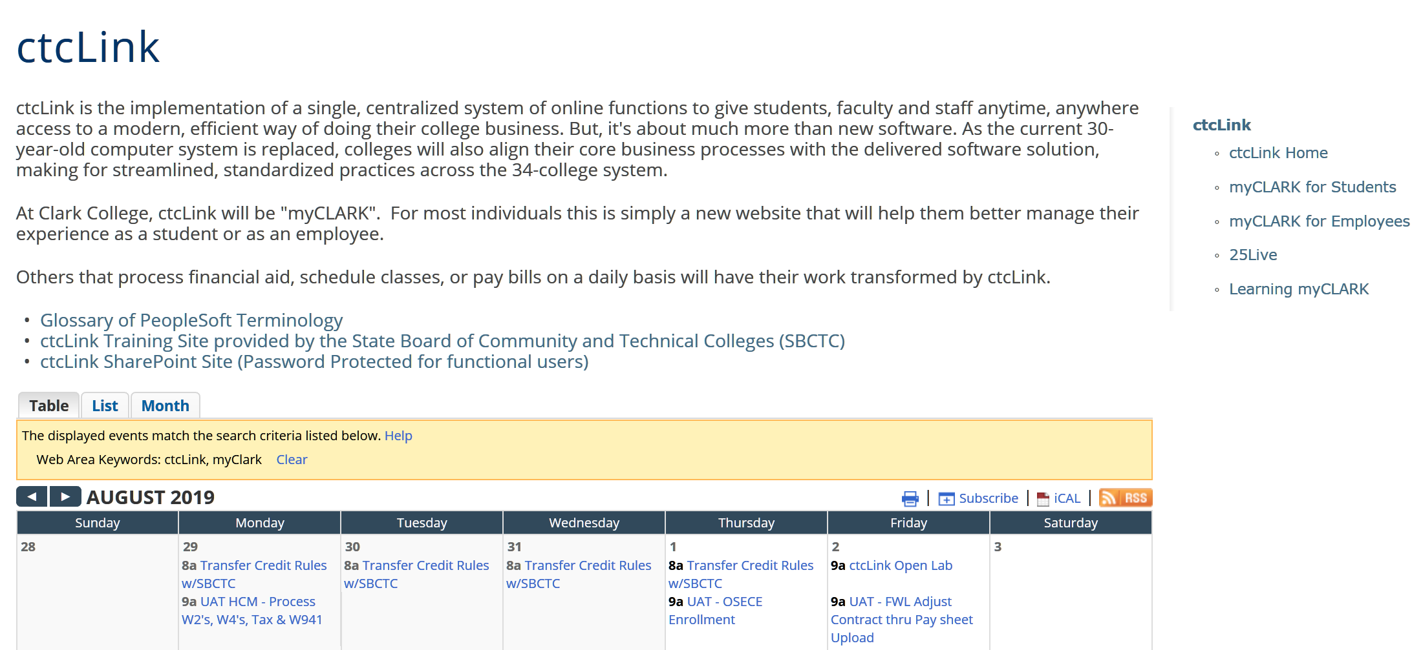
Information www.clark.edu/myclark
Notes:
Susan – where to find information

Slide 8
Dates & Deadlines
September 27 – Last day to issue fall work-study referrals.
September 30 – Last day for purchasing. No purchasing in October.
October 4 – Last Day for submission of travel advance requests.
October 15 – Time Sheets must be in on time. If you miss the deadline we will not be able to write a check. You will be paid with the Nov 10th pay.
October 15 – Last day for corrections to winter classes
October 16 to 31 – no new employees processed. November 1st will be start date.
October 17 – last day for student enrollment transactions.
October 22 – Business Services closes financial books
Notes:
Sabra Sand is the Director of Business Services and the Pillar Lead for Finance
Sabra: review important dates and why we need to impose deadlines.

Slide 9
Legacy Shutdown
October 17 – Last day for enrollment transactions
October 18 – Web transaction server and Cybersource down
October 24 – Legacy system taken down
October 25 to 27 – convert data from Legacy to PeopleSoft
October 28 – Begin to log into PeopleSoft
Notes:
Sabra: focuses more on student transactions and legacy

Slide 10
When do we have access to PeopleSoft?
Sunday 10/27 | Monday 10/28 | Tuesday 10/29 | Wednesday 10/31 | Thursday 10/31
SMES | Legacy Super Users | Non Legacy Users |  | Students
EC | Supervisors | Faculty Advisors |  | ECD Students
IT Service Center | Administrative Support | Faculty
Tech Hub | Club Advisors
Notes:
Susan: Groups will receive an email with the link to be able to sign in as a new user. Reminder – write down that PS ID when you see it, or else you will need to call the help desk.
Students will not access the system until Thursday. This allows time for staff to review student records and enter any data as necessary.

Slide 11
How will I know what to do?
Start with the Fundamentals / Orientation
  Clark led classes
  Self-paced course in Canvas
  Videos
  Open Labs – Fridays 9-noon
    August 16 and 23
    September 6 and 13
Notes:
Jennifer Ward is a our training lead. She is teaching the fundamentals classes and coordinating the other trainings. She can help you with canvas.
Jennifer: There are many ways available to you to learn about PeopleSoft. We are in the process of scheduling sessions.

Slide 12
How will I know what to do?
Instructor led classes, by SBCTC staff via webex
Self-paced course in Canvas
ctcLink Reference Center – Quick Reference Guides (QRG)
Videos
Open Labs
Clark led classes
Ask a SME
Notes:
Jennifer: There are many ways available to you to learn about PeopleSoft. We are in the process of scheduling sessions.

Slide 13
How will students know what to do?
Email to students – beginning of Fall term
Videos on website
MyClark ctcLink Quick Reference Guides
Open Labs
Tech Hub available in Gaiser
MyClark Triage Center
College 101
Notes:
Mirranda Saari is the Associate Dean of Enrollment and Registrar, along with being the pillar lead for Campus Solutions.
Mirranda: How will student know what to do?
Beginning of fall term we will begin communications to students. At GoLive we will have a variety of resources available. Discuss the list.

Slide 14
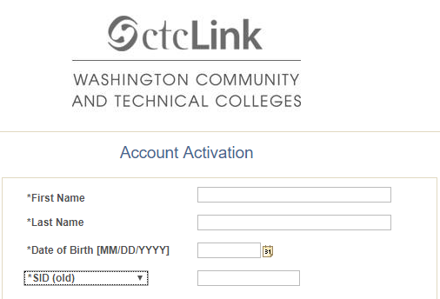
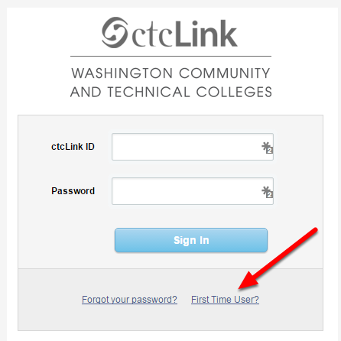

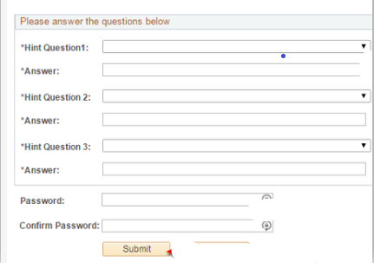
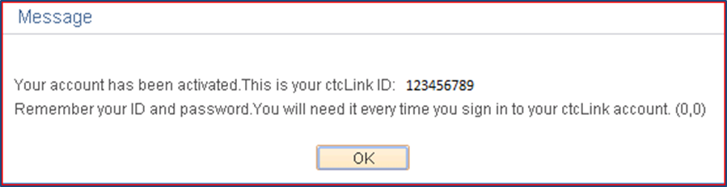
  Logging Into ctcLink
  – for the first time
ctcLink – Live
First time logging in and activating your ctcLink Account
  Click on First Time User
  Enter Required information
  Change ctcLink ID to SID (old)
  Answer Security Questions
  Write down your ctcLink ID
Notes:
Jennifer / Susan

Slide 15
What if I have a technology issue with ctcLink.
ITS Service Center
Icon on your desktop
Call x2425
Notes:
Susan

Slide 16
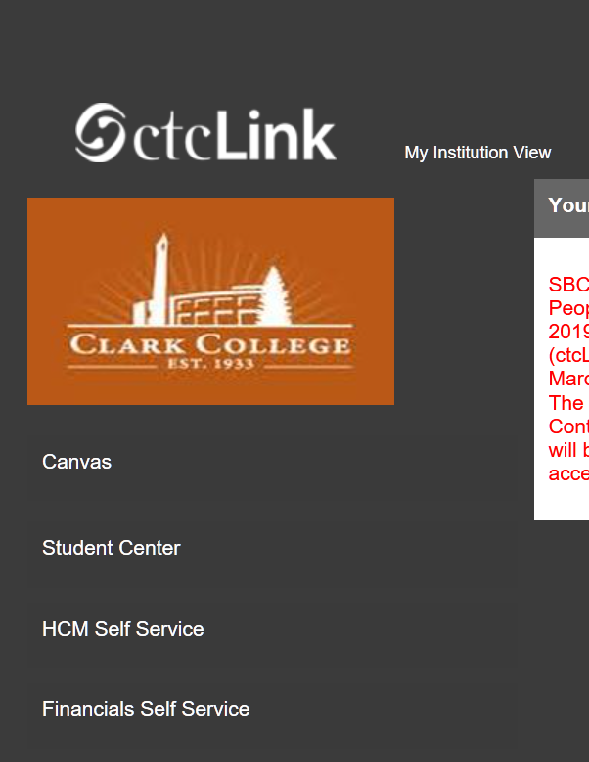
What you see on the left sidebar are the self-service areas you have access to.

Slide 17
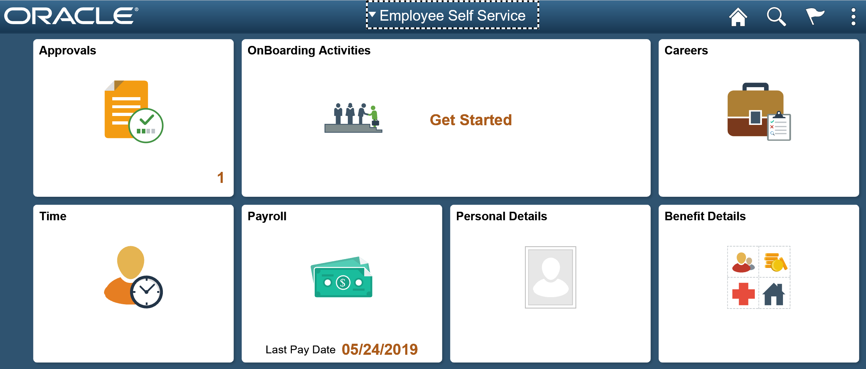
Notes:
Guisela Eberle is the Assistant Director of Human Resources and our HCM pillar lead/ Susan
Guisela: What will be available for ALL employees – view of Employee Self Service. Next slide is how most will view this information.

Slide 18
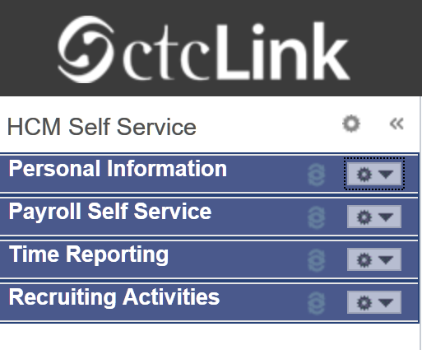
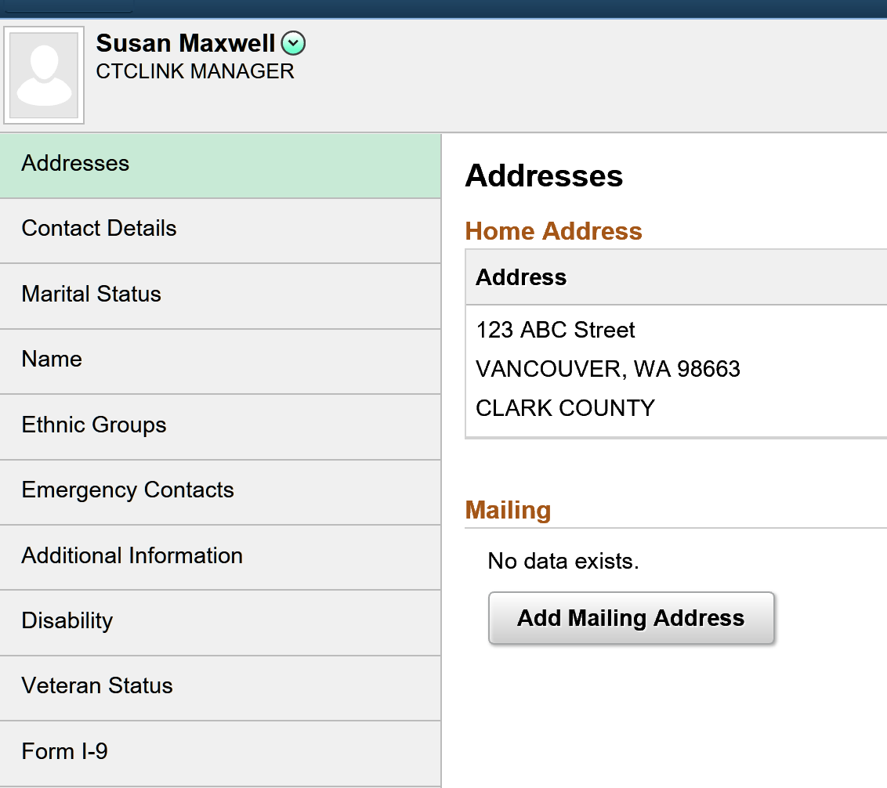
Notes:
Guisela: Brief overview of each: personal info, payroll, time and leave

Slide 19
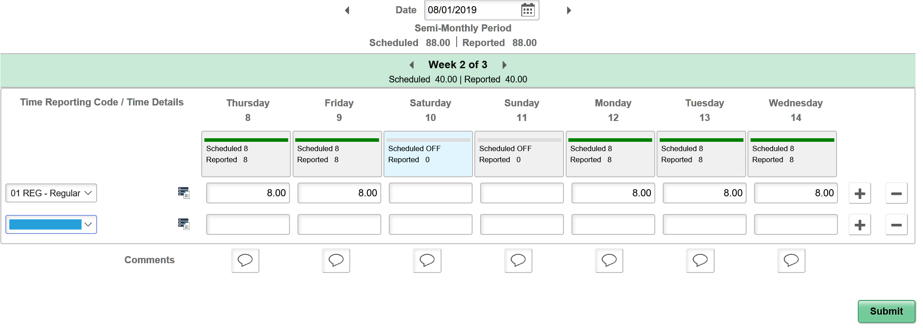
Request
Approval
Use
Notes:
Guisela: You can’t enter other time options until they have been approved by your supervisor.

Slide 20
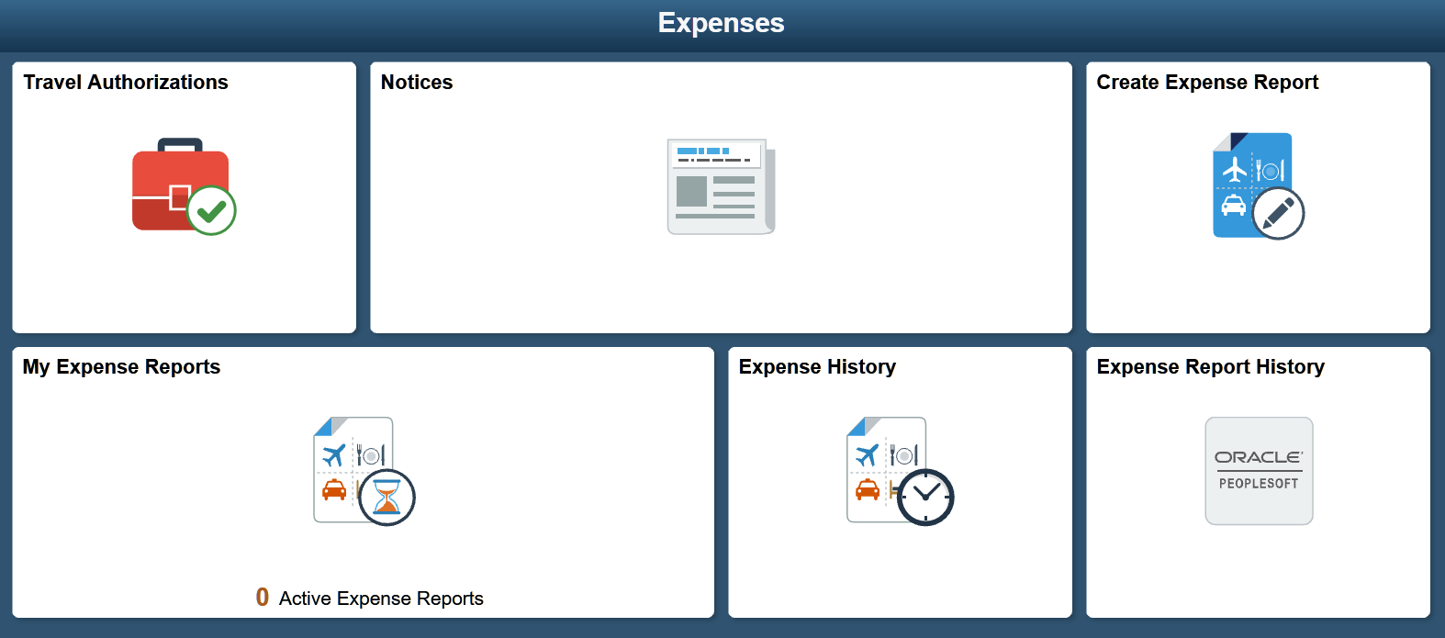
Notes:
Sabra: explain travel authorization and then expense report is done here. Everyone will have access to this.

Slide 21
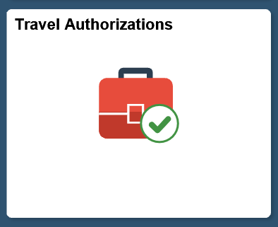
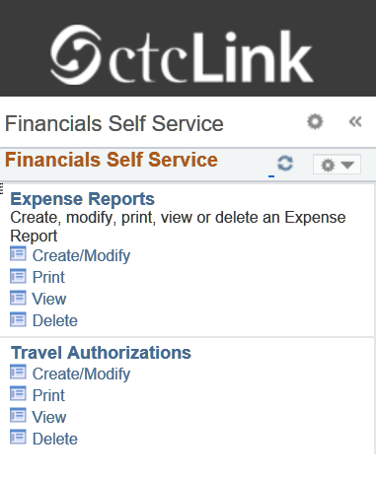
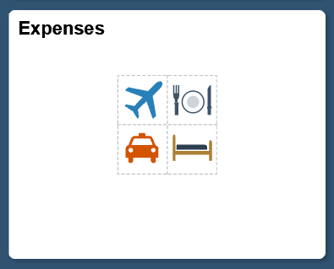
Notes:
Sabra: details of the two areas

Slide 22
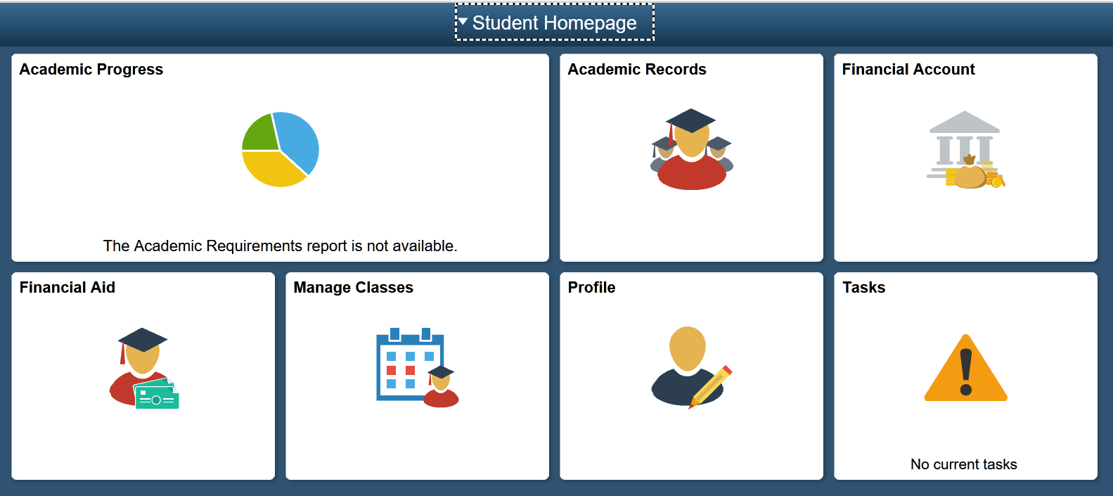
Notes:
Mirranda: if we have time talk about the splendors of the student center.

Slide 23
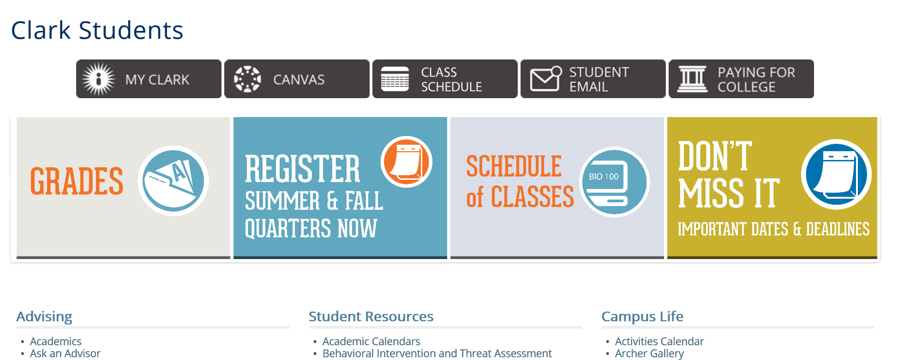
Notes:
Students will still come to this landing page to access MyClark ctcLink.

Slide 24
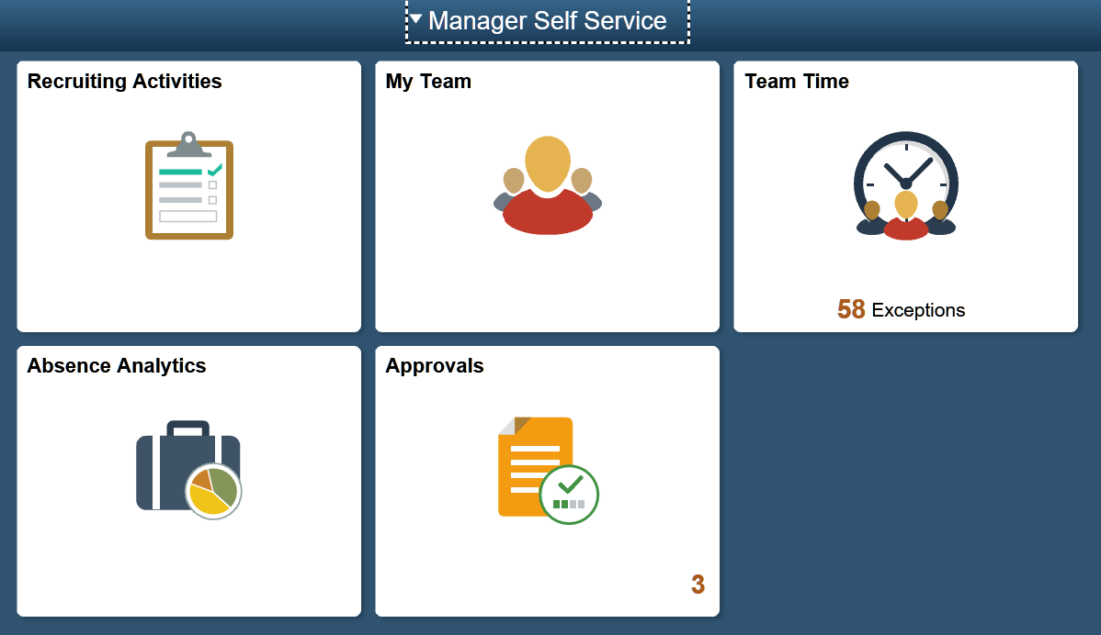
Notes:
Susan: If you are a manager you will have manager self service.

Slide 25


Slide 26

Questions?

